Slide 1
Mississippi’s Annual Affordable Housing Conference 2022
CHEERS TO 30 YEARS!
Beau Rivage Resort & Casino
Biloxi, MS
March 29-31

Slide 2
2022 Disaster Credits
Special Cycle

Slide 3
IRS Notice 2021-45 August 2, 2021
Summarizes requirements detailed in Taxpayer Certainty and Disaster Tax Relief Act of 2020 (amended CARES Act)
Defines a Qualified Disaster Zone as the portion of any qualified disaster area which was determined by the President during the period beginning on January 1, 2020, and ending on February 25, 2021 (Section 305)
Incident Period: On or after December 28, 2019, and before or on December 27, 2020 (Section 301)
Disaster LIHTCs are equal to the lesser of $3.50 multiplied by the population in the disaster zones or 65% of the state LIHTC ceiling for calendar year 2020 (Section 301)
Identifies States (11) and Counties eligible for the credits and combined populations

Slide 4
Available Annual Credit Authority
2021 and 2022
Population figure used for credit calculation is county-level estimates as of July 1, 2019 (US Census Bureau 3/26/2020)
Combined County Population: 667,359
Available Annual Credit Authority: $4,671,513

Slide 5
Eligible Counties
The President of the United States issued major declarations in 11 States and Puerto Rico that met the criteria of the Act.
Mississippi counties (15)
Clarke, Covington, George, Greene, Grenada, Hancock, Harrison, Jackson, Jasper, Jefferson Davis, Jones, Lawrence, Panola, Stone, and Walthall.

Slide 6
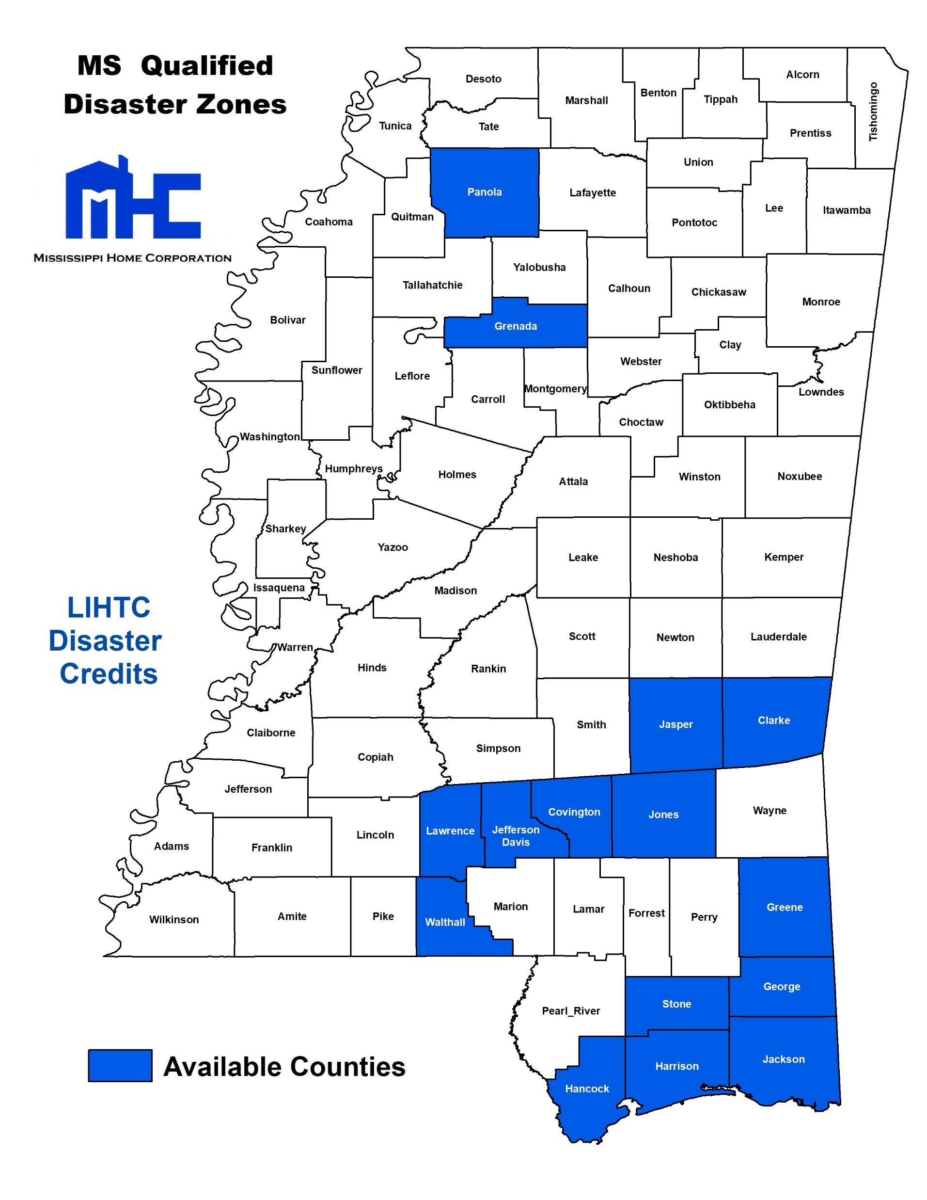

Slide 7
Disaster Declarations
Major disasters resulting in declarations meeting the criteria of the Act are:
DR-4576-MS Hurricane Zeta
George, Greene, Hancock, Harrison, Jackson, and Stone
1,607 households impacted ranging from destroyed, to minor and major damage
DR-4536-MS Severe Storms, Tornadoes, Straight-line Winds, and Flooding.
Covington, Jefferson Davis, and Jones
543 households impacted ranging from destroyed, to minor and major damage
*Source: www.fema.org

Slide 8
Key Dates
Application Cycle
Technical Assistance
Compliance Verification
Waiver Request
Evidence of Community Notification
*Resubmit Compliance letter if applied in 2022 Cycle
July 11-15
April 20-July 9
May 11
June 1
July 1

Slide 9
QAP Amendments
Public Hearing
Separate online application
Maximum Annual Credit Award: $750,000
Set-Asides remain the same
Allowance for $1,500,000 for 60 or more units has been removed
Only one award per applicant
Site Location modified
10 points if wholly located in a Qualified Disaster Zone
Submit MHC Layer Map evidencing disaster zone
Over-concentration has been removed
*Final amendments issued in a Program Bulletin

